Slide 1
WELCOME TO

Slide 2
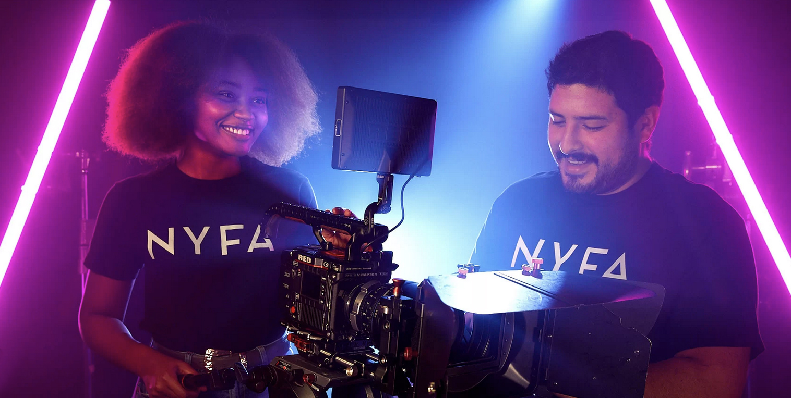
We are NYFA Video

Slide 3
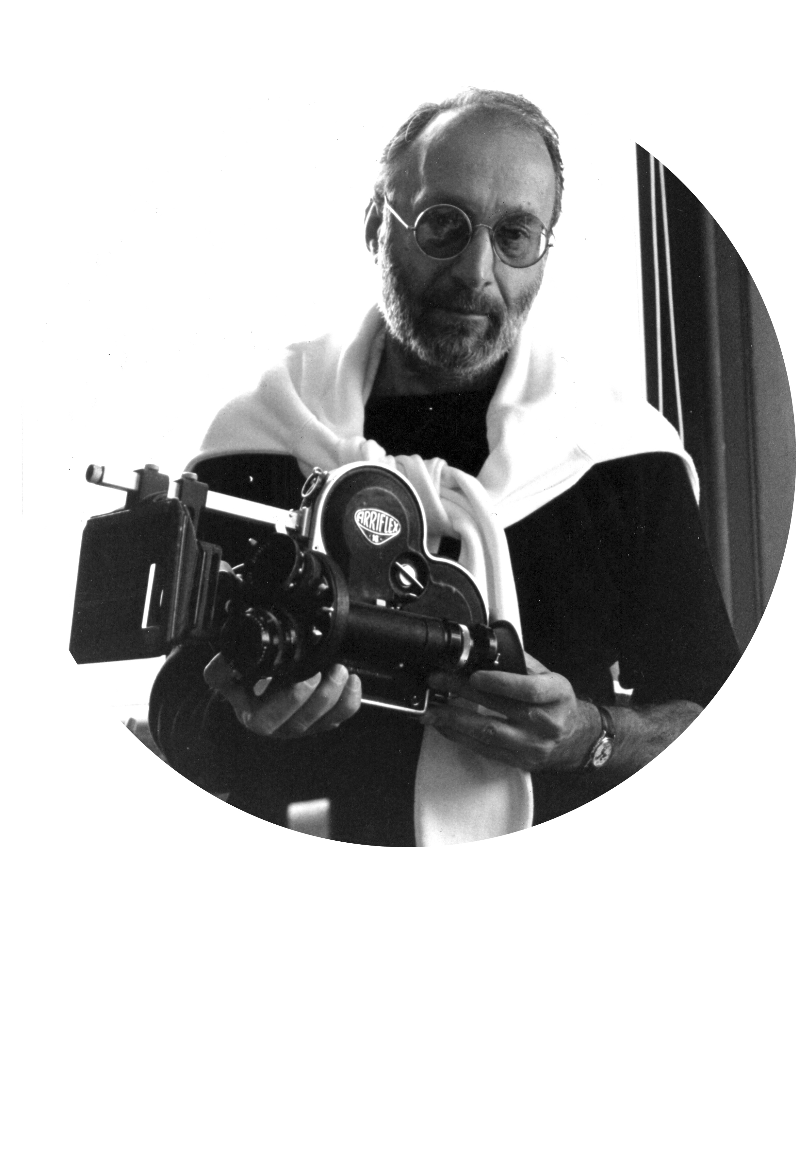
Teaching Philosophy and Mission
• Founded in 1992
• Training STORYTELLERS
• Intensive
• Hands-on
• Project based curriculum
• Small classes

Slide 4
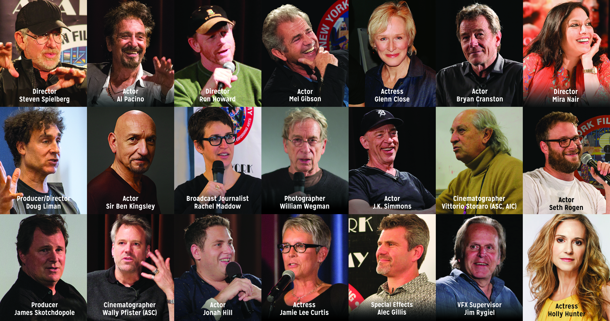
Guest Speakers

Slide 5
Alumni Highlight

Slide 6
Facilities and Equipment
• Top of the line, cutting edge equipment
• Attend program, learn the equipment and start working

Slide 7
Programs by Major
Film Arts
Media Arts
Performing Arts
• Filmmaking
• Producing
• Screenwriting
• Cinematography
• Documentary Filmmaking
• Digital Editing
• Photography
• 3D Animation & VFX
• Broadcast Journalism
• Game Design
• Virtual Reality
• Acting for Film
• Musical Theater

Slide 8
Programs by Length
• Degree Programs (MFA, MA, BFA, BA & AFA)
• 1 & 2-Year Conservatory
• Short-Term Workshops
• Teens Camps (Ages 17-14)
• Kids Camps (Ages 13-10)

Slide 9
Locations
Permanent Locations
South Beach, Miami, FL
New York City, NY
Florence, Italy
Los Angeles, CA
Gold Coast, Australia
Satellite Locations
Programs all over the world
• Harvard University • Paris • Beijing & Greater China

Slide 10
Admissions
Requirements
• Short-Term
• 1 & 2-year Conservatory
• Degree Programs

Slide 11
Admissions
• Federal Financial Aid Approved
(Domestic Students)
• Veterans Benefits
• Select governmental loans/ scholarships
(International Students)

Slide 12
Admissions
Needs Based Tuition Discount
• All Programs of 1 Year or longer
Talent Based Discount
• 1 & 2-Year Acting and Musical Theater
• All degree programs

Slide 13
Admissions
Housing
• Housing offered in NYC for long-term students
• Housing coordinators at all locations to assist
student in finding housing

Slide 14
International Students
All programs of 4 weeks or longer are eligible for a student visa
• I-20 Process
• Visa Process
Optional Practical Training (OPT)

